Slide 1




Codebasics SQL Challenge

Slide 2
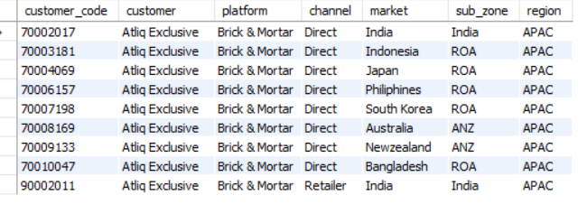
Question
1. Provide the list of markets in which customer "Atliq Exclusive" operates its business in the APAC region.
OUTPUT

Slide 3

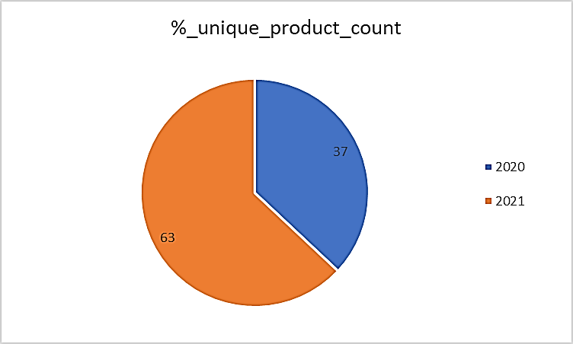
Question
2. What is the percentage of unique product increase in 2021 vs. 2020?
The final output contains these fields,
unique_products_2020
unique_products_2021
percentage_chg
OUTPUT

Slide 4
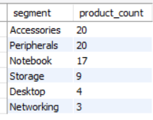
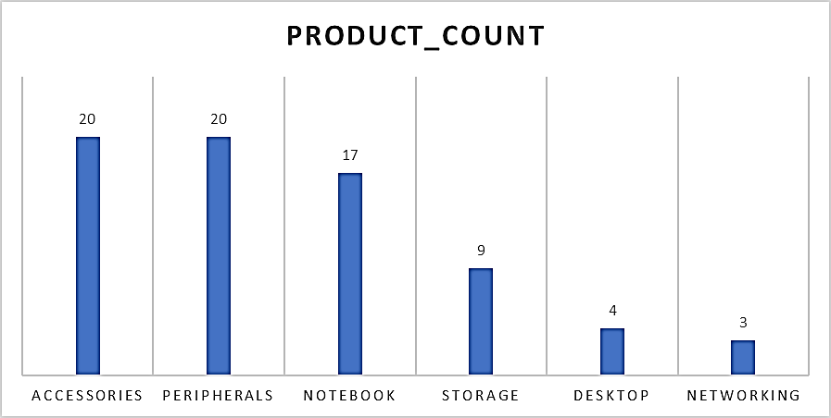
Question
3. Provide a report with all the unique product counts for each segment and sort them in descending order of product counts.
The final output contains 2 fields,
segment
product_count
OUTPUT

Slide 5
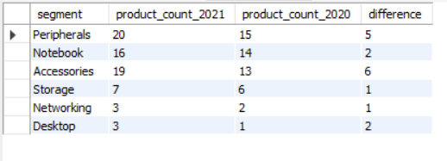
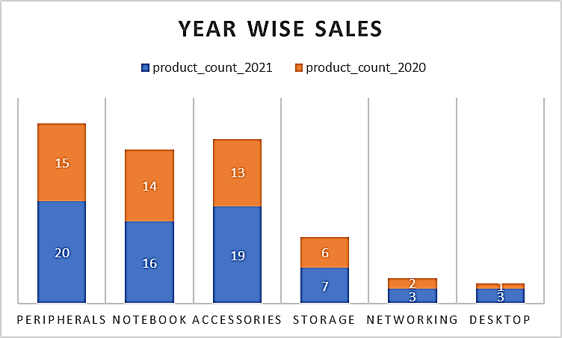
Question
4. Follow-up: Which segment had the most increase in unique products in 2021 vs 2020?
The final output contains these fields,
segment
product_count_2020
product_count_2021
difference
OUTPUT

Slide 6
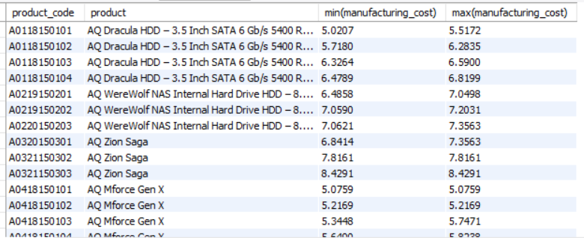
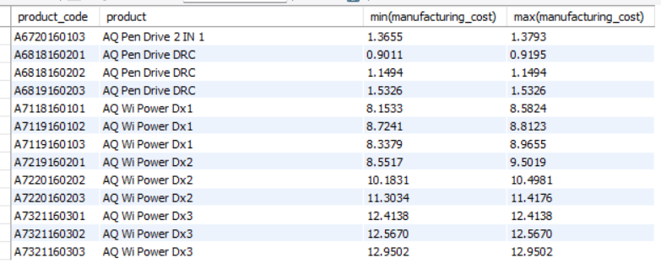
Question
5. Get the products that have the highest and lowest manufacturing costs.
The final output should contain these fields,
product_code
product
manufacturing_cost
OUTPUT

Slide 7
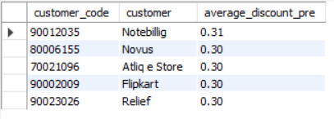
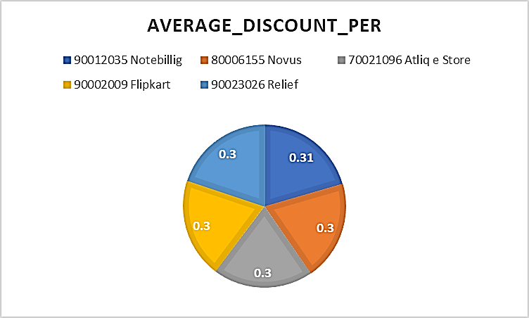
Question
6. Generate a report which contains the top 5 customers who received an average high pre_invoice_discount_pct for the fiscal year 2021 and in the Indian market.
The final output contains these fields,
customer_code
customer
average_discount_percentage
OUTPUT

Slide 8
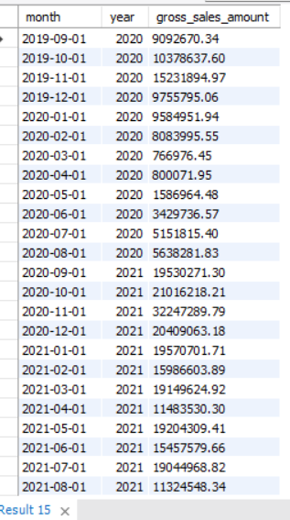
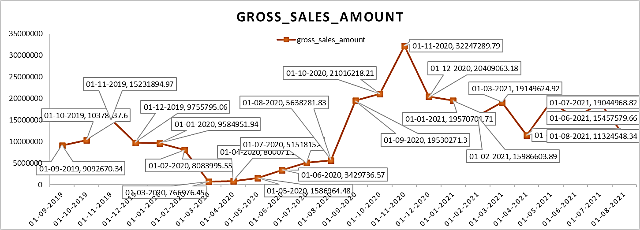
Question
7. Get the complete report of the Gross sales amount for the customer “Atliq Exclusive” for each month. This analysis helps to get an idea of low and high-performing months and take strategic decisions.
The final report contains these columns:
Month
Year
Gross sales Amount
OUTPUT

Slide 9
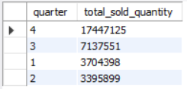
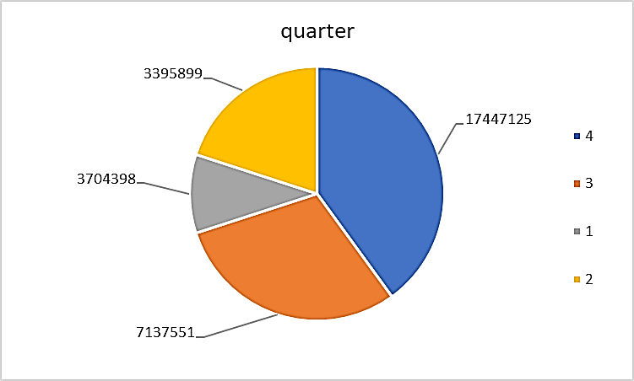
Question
8. In which quarter of 2020, got the maximum total_sold_quantity?
The final output contains these fields sorted by the total_sold_quantity,
Quarter
total_sold_quantity
OUTPUT

Slide 10
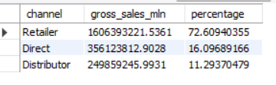
Question
9. Which channel helped to bring more gross sales in the fiscal year 2021 and the percentage of contribution?
The final output contains these fields,
channel
gross_sales_mln
percentage
OUTPUT

Slide 11
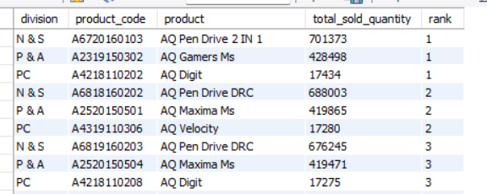
Question
10. Get the Top 3 products in each division that have a high total_sold_quantity in the fiscal_year 2021?
The final output contains these fields,
division
product_code
product
total_sold_quantity
rank_order
OUTPUT

Slide 12


